Slide 1

Parking Lot Management Application
Efficient Parking Control for Any Size Lot
Presented by: Simadri Sai Bighnesh Prusty

Slide 2

The Problem
Manual tracking is:
Error-prone
Time-consuming
Lacks real-time insights
No historical data

Slide 3
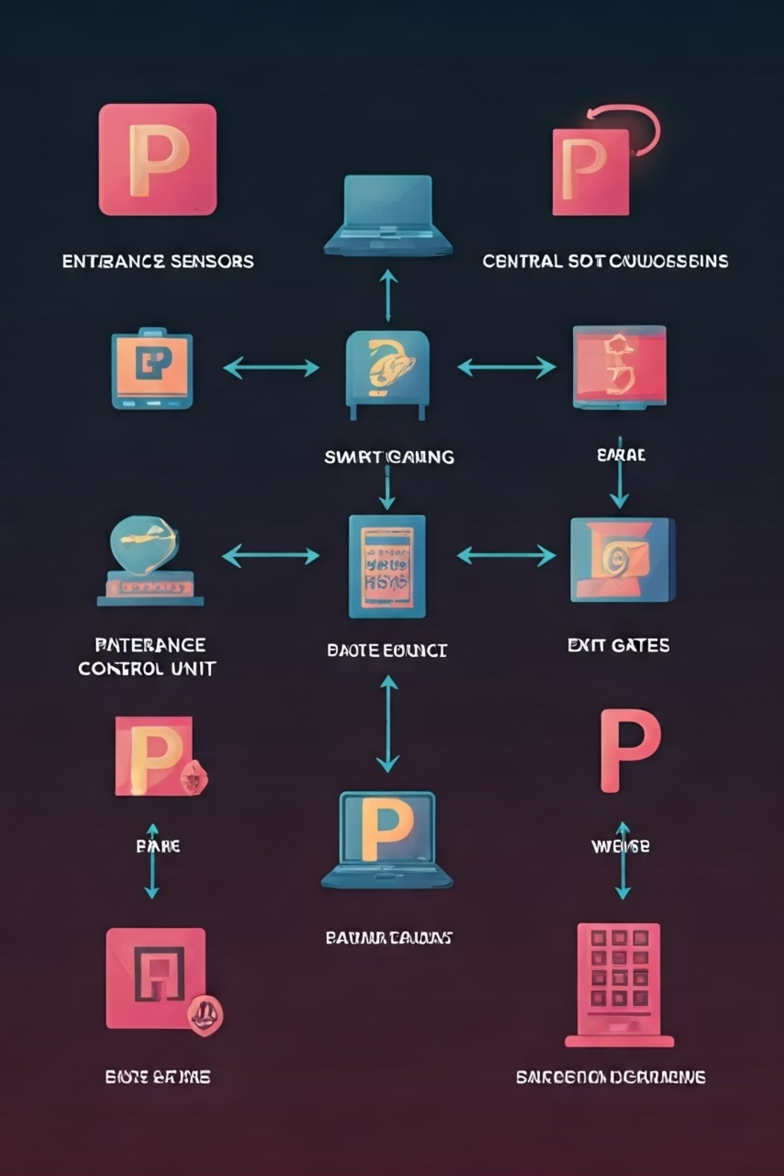


System Architecture
ParkingLotApp
Vehicle & ParkingSlot
Main entry point, handles user interaction
Core objects with size compatibility

Slide 4
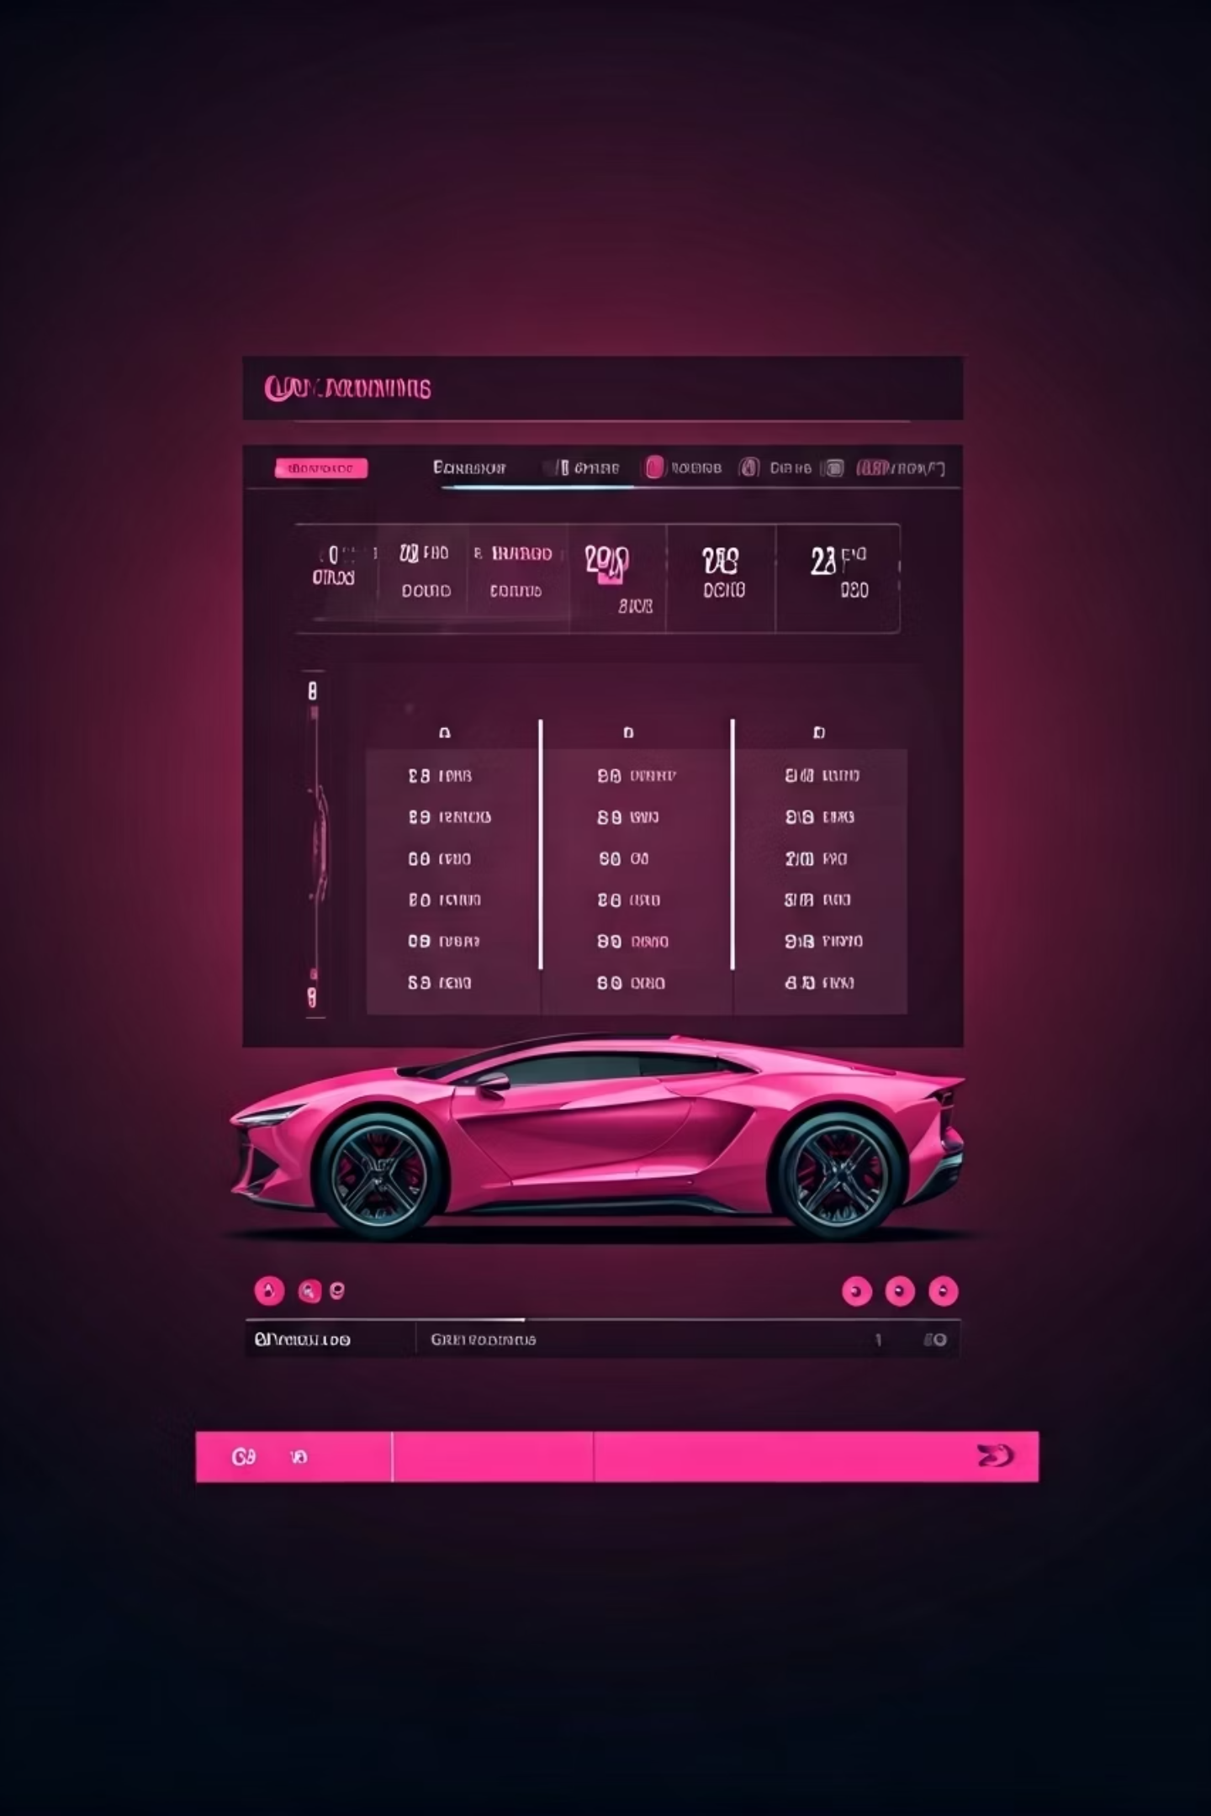



Smart Features
Dynamic Initialization
User defines N slots, auto-categorized
Smart Parking
Size compatibility check before plate entry
Real-time Status
Instant overview of all slots

Slide 5

Automated Reporting
Report Generated on Exit
Filename: parking_lot_report_DD-MM-YYYY.txt
Slot distribution
Current status
Complete parking history
Timestamp details

Slide 6

Simple Setup & Execution
Run
Compile
java ParkingLotApp
Save Code
javac ParkingLotApp.java
Save as ParkingLotApp.java
Requires only JDK 11+

Slide 7
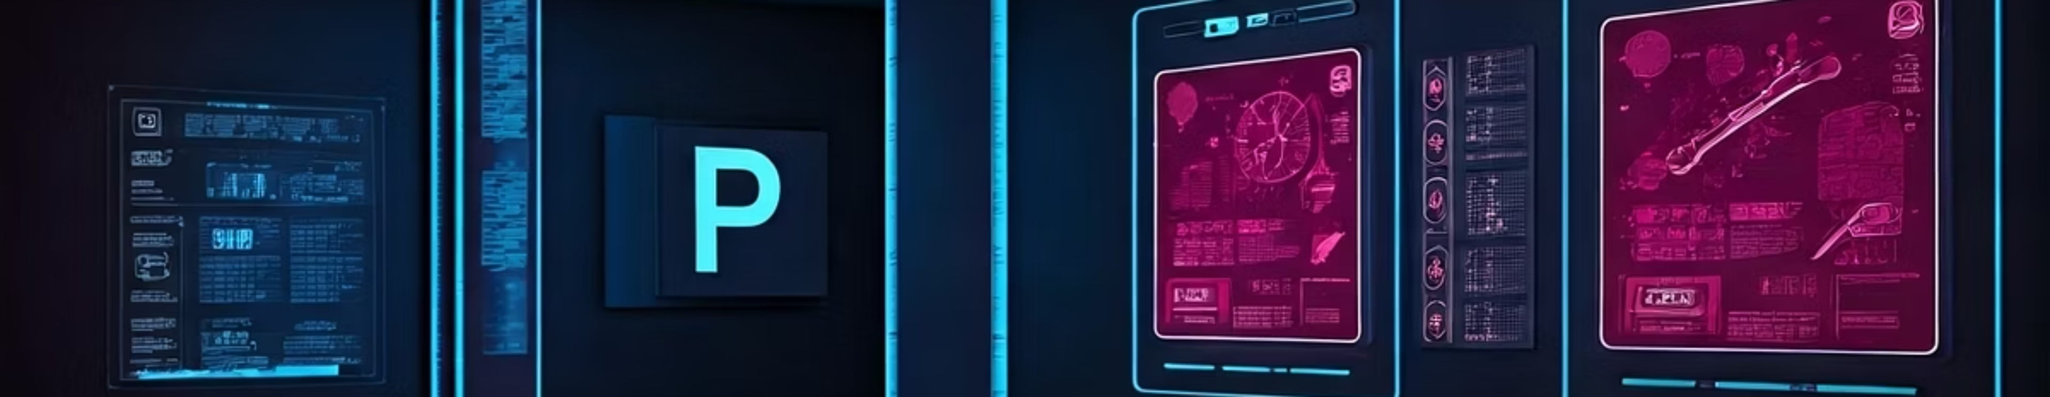




Future Roadmap
Data Persistence
Graphical Interface
Save/load between sessions
Visual experience upgrade
Analytics
Payment System
Usage patterns & insights
Fee calculation & processing

